Slide 1

Multidimensional Data Analysis
Master IOT
Notes:
Paramétrez vos champs : numéros de pages, titre de la présentation en pied de page et date dans le menu INSERTION > EN-TÊTE ET PIED DE PAGE et cliquez sur APPLIQUER PARTOUT

Slide 2

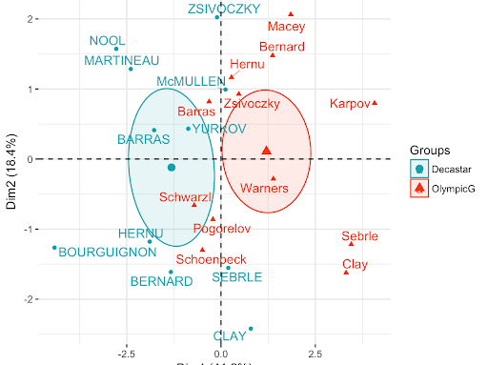
Main methods
Principal Component Analysis (PCA)
Factorial axes
Main components reconstitution formula
Percentage of information
Representation of variables
Representation of individuals
Quality of representations
Input Data for k-means

Slide 3
Main methods
Data | Method | Acronym
V. Quantitative | Principal Component Analysis | PCA
T. Distance | Factor Analysis of a Distance Table | FADT
T. Contingency | Factorial Correspondence Analysis | FCA
V. Qualitative | Multiple Correspondence Analysis | MCA

Slide 4
PCA
A classic in data analysis for scoping or compressing a large n × p array of quantitative data.
Several presentations
Statistical presentation: search for new variables, linear combinations of old ones
Geometric presentation: search for affine subspaces

Slide 5
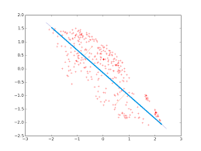
Factorial axes (or main axes of inertia)
Mathematical formulation
Objective: obtain a faithful representation of the cloud of individuals in a simpler space than the initial space
Space retained:
Affine space of dimension k: line, plan,…
Fidelity measurement: sum of the differences between the points of the cloud and their projections
Inertia with respect to the affine space
Problem: find the affine subspace E_{k} of dimension k minimizing I_{EK}
If I had to project my
point cloud on a
line ... the blue line
seems more ideal than the
green line

Slide 6
Factorial axes (or main axes of inertia)
It is the variance-covariance matrix (or the correlation matrix) that will allow this relevant summary to be produced, because we are essentially analyzing the dispersion of the data considered.
Extract from this matrix, by an appropriate mathematical process, the factors that you are looking for.
These factors will make it possible to produce the desired graphs in this small-dimensional space (the number of factors retained), while distorting the overall configuration of individuals as little as possible according to all of the initial variables (thus replaced by the factors).

Slide 7
Interpretation
Interpreting the graphs will help to understand the structure of the analyzed data.
Guided by a number of numerical and graphical indicators, which are there to help the user make the most accurate and objective interpretation possible.

Slide 8
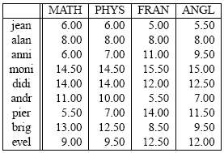
Basic presentation of the PCA
Consider the grades (from 0 to 20) obtained by 9 students in 4 disciplines (mathematics, physics, French, English):

Slide 9
Basic presentation of the PCA
What we know:
How to analyze each of these 4 variables separately, either by making a graph or by calculating numerical summaries.
Also, we can look at the links between 2 variables (for example mathematics and French), either by making a graph of the point cloud type, or by calculating their linear correlation coefficient, or even by performing the regression of one on the other.
But!, How to do a simultaneous study of the 4 variables?
Space of dimension 4 (not graphically representable !!)
Objective: to return to a space of reduced dimension (for example, here, 2) while distorting reality as little as possible. It is therefore a question of obtaining the most relevant summary of the initial data.

Slide 10
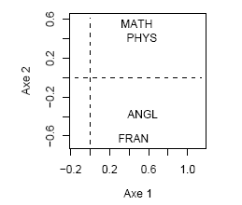
Representation of variables

Slide 11
Interpretation
The first factor is positively correlated, and quite strongly, with each of the 4 initial variables: the more a student obtains good marks in each of the 4 disciplines, the more he has a high score on the axis; Conversely, the worse his grades, the more negative his score.
Axis 2 opposes, one part, French and English (positive correlations), on the other hand, mathematics and physics (negative correlations). It is therefore an axis of opposition between literary and scientific disciplines, above all marked by the opposition between French and Mathematics.

Slide 12
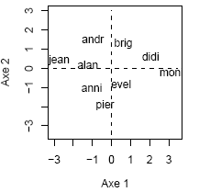
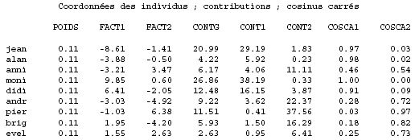
Results of individuals
The table below contains all the important results on individuals.

Slide 13
Interpretation
We can thus see that axis 1 represents the overall result of the students (if we took their score or coordinates on axis 1, we would obtain the same ranking as if we took their general average). Moreover, the “highest” student on the graph, the one with the highest coordinate on axis 2, is Pierre, whose results are the most contrasted in favor of literary disciplines (14 and 11.5 against 7 and 5.5). It is exactly the opposite for André, who obtains the average in science disciplines (11 and 10) but very poor results in literary disciplines (7 and 5.5). Note that Monique and Alain have a score close to 0 on axis 2 because they have very homogeneous results in the 4 disciplines (but at very different levels, which axis 1 has already revealed).

Slide 14
Qualité de représentation des individus
The last 2 columns of the table are square cosines which carry the (* quality of the representation *) of each individual on each ax.
These quantities add up ax by ax, so that, in dimension 2, Evelyne is represented at 98% (0.25 + 0.73), while the other 8 individuals are at 100%.
When we summarize the data in dimension 2, and therefore we represent them in a plane, each individual is then represented by the projection of the initial vector on the plane in question

Slide 15
Thank You

